Slide 1
Theorem Proving Tools for Program Analysis SMT Solvers: Yices & Z3 Austin, Texas 2011
Nikolaj Bjørner ², Bruno Dutertre¹, Leonardo de Moura²
SRI International¹, Microsoft Research²

Slide 2
SMT@SRI: Yices
TBD: add overview of Yices

Slide 3

SMT@Microsoft: Z3
Z3 is a new solver developed at Microsoft Research.
Development/Research driven by internal customers.
Free for academic research.
Interfaces:
http://research.microsoft.com/projects/z3
Z3
Text
C/C++
.NET
OCaml

Slide 4
Syllabus
The Logic of SMT solvers
Decidability and Decision Procedures
User Interaction and Guidance
Main Applications

Slide 5
The Logic of SMT Solvers

Slide 6
The Logic of SMT Solvers
SMT: Satisfiability Modulo Theories
Input: a first-order formula ϕ over background theory
Output: is ϕ satisfiable?
does ϕ have a model?
Is there a refutation of ϕ = proof of ¬ϕ?
For most SMT solvers: ϕ is a ground formula
Background theories: Arithmetic, Arrays, Bit-vectors, Algebraic Datatypes
Most SMT solvers support simple first-order sorts

Slide 7
Satisfiability Modulo Theories (SMT)
b + 2 = c and f(read(write(a,b,3), c-2)) ≠ f(c-b+1)

Slide 8
Satisfiability Modulo Theories (SMT)
b + 2 = c and f(read(write(a,b,3), c-2)) ≠ f(c-b+1)
Arithmetic

Slide 9
Satisfiability Modulo Theories (SMT)
b + 2 = c and f(read(write(a,b,3), c-2)) ≠ f(c-b+1)
Array Theory
Arithmetic

Slide 10
Satisfiability Modulo Theories (SMT)
b + 2 = c and f(read(write(a,b,3), c-2)) ≠ f(c-b+1)
Uninterpreted Functions
Array Theory
Arithmetic

Slide 11
Satisfiability Modulo Theories (SMT)
b + 2 = c and f(read(write(a,b,3), c-2)) ≠ f(c-b+1)
Substituting c by b+2

Slide 12
Satisfiability Modulo Theories (SMT)
b + 2 = c and f(read(write(a,b,3), b+2-2)) ≠ f(b+2-b+1)
Simplifying

Slide 13
Satisfiability Modulo Theories (SMT)
b + 2 = c and f(read(write(a,b,3), b)) ≠ f(3)

Slide 14
Satisfiability Modulo Theories (SMT)
b + 2 = c and f(read(write(a,b,3), b)) ≠ f(3)
Applying array theory axiom
forall a,i,v: read(write(a,i,v), i) = v

Slide 15
Satisfiability Modulo Theories (SMT)
b + 2 = c and f(3) ≠ f(3)
Inconsistent/Unsatisfiable

Slide 16
SMT formulas - Overview
Simple sorts: Bool - Booleans Int, Real - Integers and Reals BitVec[32], BitVec[n] - Bit-vectors (Array Int Int) - Arrays
Sorted Terms:
(+ (xCoord q) (yCoord q))
Formulas = Terms of Boolean Sort Quantified formulas: (forall ((x Int)) (=> (> x 0) (p x)))

Slide 17






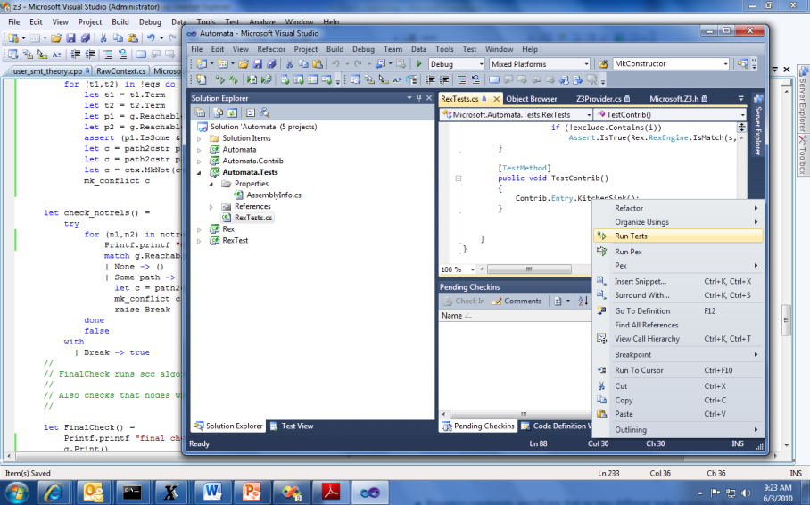


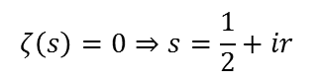
SMT by Example: Job Shop Scheduling
Machines
Tasks
Jobs
P = NP?
Laundry
$$ζ\left(s\right)=0⇒s=\frac{1}{2}+ir$$

Slide 18
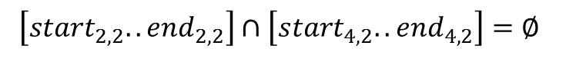
Job Shop Scheduling
Constraints:
Precedence: between two tasks of the same job
Resource: Machines execute at most one job at a time
3
1
2
4
$$\left[start_{2,2}..end_{2,2}\right]∩\left[start_{4,2}..end_{4,2}\right]=∅$$

Slide 19
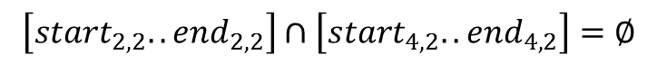
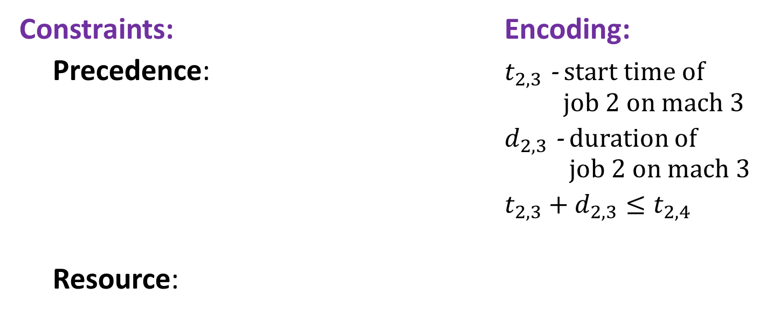
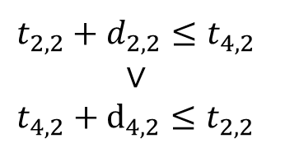
Job Shop Scheduling
Constraints: Encoding:
Precedence: $t_{2,3}$ - start time of job 2 on mach 3
$d_{2,3}$ - duration of job 2 on mach 3
$t_{2,3}+d_{2,3}≤t_{2,4}$
Resource:
3
1
4
2
Not convex
$$t_{2,2}+d_{2,2}≤t_{4,2}$$
$$∨$$
$$t_{4,2}+d_{4,2}≤t_{2,2}$$
$$\left[start_{2,2}..end_{2,2}\right]∩\left[start_{4,2}..end_{4,2}\right]=∅$$

Slide 20
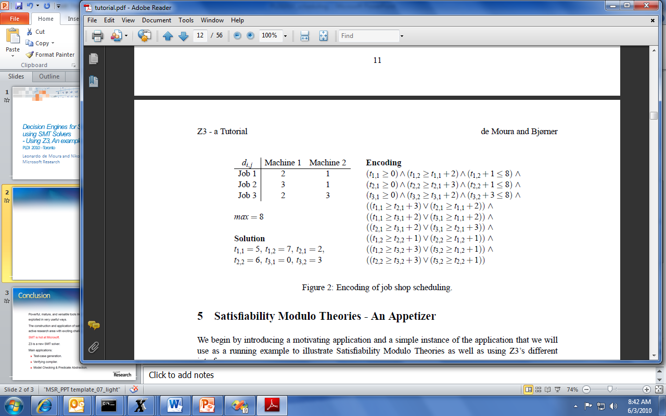
Job Shop Scheduling

Slide 21
Job Shop in SMT-LIB2
SMT-LIB2 is a format for exchanging benchmarks between SMT solvers.
It is also convenient for text-based interaction.
Z3 supports SMT-LIB2 + additional goodies

Slide 22
Job Shop in SMT2
Start Z3 using smt-lib mode in interactive (/si) enable models (/m).
Z3.exe /smt2 /is /m
Optionally specify the logic. The benchmark is going to use Integer Difference Logic and use the a solver for difference logic
(set-logic QF_IDL)
(declare-fun t11 () Int)
(declare-fun t12 () Int)
(declare-fun t21 () Int)
(declare-fun t22 () Int)
(declare-fun t31 () Int)
(declare-const t32 Int)
Declare constants that are going to be used in the problem.
Constants are functions that don’t take any arguments.
Z3 shorthand for declare-fun … () ..

Slide 23
Job Shop in SMT2
Add the precedence constraints
(assert (and (>= t11 0) (>= t12 (+ t11 2)) (<= (+ t12 1) 8)))
(assert (and (>= t21 0) (>= t22 (+ t21 3)) (<= (+ t22 1) 8)))
(assert (and (>= t31 0) (>= t32 (+ t31 2)) (<= (+ t32 3) 8)))

Slide 24
Job Shop in SMT2
Add the resource constraints
(assert (or (>= t11 (+ t21 3)) (>= t21 (+ t11 2))))
(assert (or (>= t11 (+ t31 2)) (>= t31 (+ t11 2))))
(assert (or (>= t21 (+ t31 2)) (>= t31 (+ t21 3))))
(assert (or (>= t12 (+ t22 1)) (>= t22 (+ t12 1))))
(assert (or (>= t12 (+ t32 3)) (>= t32 (+ t12 1))))
(assert (or (>= t22 (+ t32 3)) (>= t32 (+ t22 1))))

Slide 25
Job Shop in SMT2
(check-sat)
(model)
Check satisfiability of the assertions
Display the model
("model" "t11 -> 5
t12 -> 7
t21 -> 2
t22 -> 5
t31 -> 0
t32 -> 2")

Slide 26
SMT2 Brief Sketch
(declare-fun id (sort*) sort) declare function
(define-fun id ((id sort)*) sort term)
define an expression shorthand
(assert term) assert formula
(check-sat) check satisfiability of assertions
(push [number]) push 1 (or number) scopes
(pop [number]) pop 1 (or number) scopes
(get-info model) model from satisfied assertions

Slide 27
SMT2 Brief Sketch
term ::= id
| number
| (id term+)
| (forall (id sort)+ term)
sort ::= id | (id sort+)
id ::= and | or | => | + | - | * | …| token | …

Slide 28
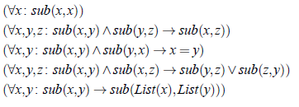
Quantifiers
Example: Single inheritance subtyping
(declare-sort Type)
(declare-fun subtype (Type Type) Bool)
(delcare-fun List (Type) Type)
(assert (forall (x Type) (subtype x x)))
(assert (forall (x Type) (y Type) (z type)
(=> (and (subtype x y) (subtype y z))
(subtype x z))))
(assert (forall (x Type) (y Type)
(=> (and (subtype x y) (subtype y x))
(= x y))))
(assert (forall (x Type) (y Type) (z type)
(=> (and (subtype x y) (subtype x z))
(or (subtype y z) (subtype z y)))))
(assert (forall (x Type) (y Type)
(=> (subtype x y)
(subtype (List x) (List y)))))

Slide 29
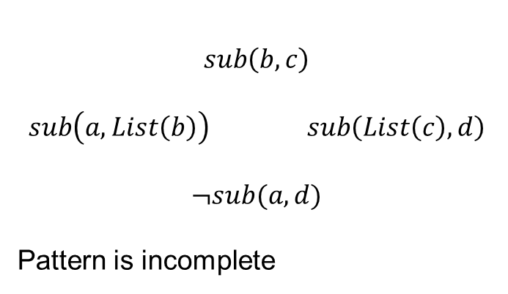
Quantifiers
Example: Single inheritance subtyping
(assert (forall (x Type) (y Type)
(=> (subtype x y)
(subtype (List x) (List y)))
:pat {(subtype (List x) (List y)) }
)
)
$$sub\left(b,c\right)$$
$$sub\left(a,List\left(b\right)\right) sub\left(List\left(c\right),d\right)$$
$$¬sub(a,d)$$
Pattern is incomplete

Slide 30
Quantifiers
Example: Single inheritance subtyping
(assert (forall (x Type) (y Type)
(=> (subtype x y)
(subtype (List x) (List y)))
:pat {(subtype x y) }
)
)
(=> (subtype a b) (subtype (List a) (List b)))
(=> (subtype (List a) (List b)) (subtype (List (List a)) (List (List b))) )
… matching loop

Slide 31
Quantifiers
Example: Single inheritance subtyping
(assert (forall (x Type) (y Type)
(=> (subtype x y)
(subtype (List x) (List y)))
:pat {(List x) (List y) }
)
)
Multi-pattern
☺ Terminates:
depth of new terms is bounded
☹ Expensive:
Quadratic
Instantiated for every pair of (List a) and (List b) created during search
.. But transitive closure is worse – it is cubic.

Slide 32
Decidability and Decision Procedures

Slide 33
Satisfiability Modulo Theories (SMT)
Is formulaϕ satisfiable modulo theory T ?
SMT solvers have specialized algorithms for T

Slide 34
Little Engines of Proof
An SMT Solver is a collection of
Little Engines of Proof

Slide 35
Little Engines of Proof
An SMT Solver is a collection of
Little Engines of Proof
Examples:
SAT Solver
Equality solver
Arithmetic, Array, Bit-vector, data-type solvers

Slide 36
User-interaction and Guidance

Slide 37
Main applications

Slide 38
Main Applications
Test case generation
Verifying Compilers
Predicate Abstraction
Invariant Generation
Type Checking
Model Based Testing

Slide 39



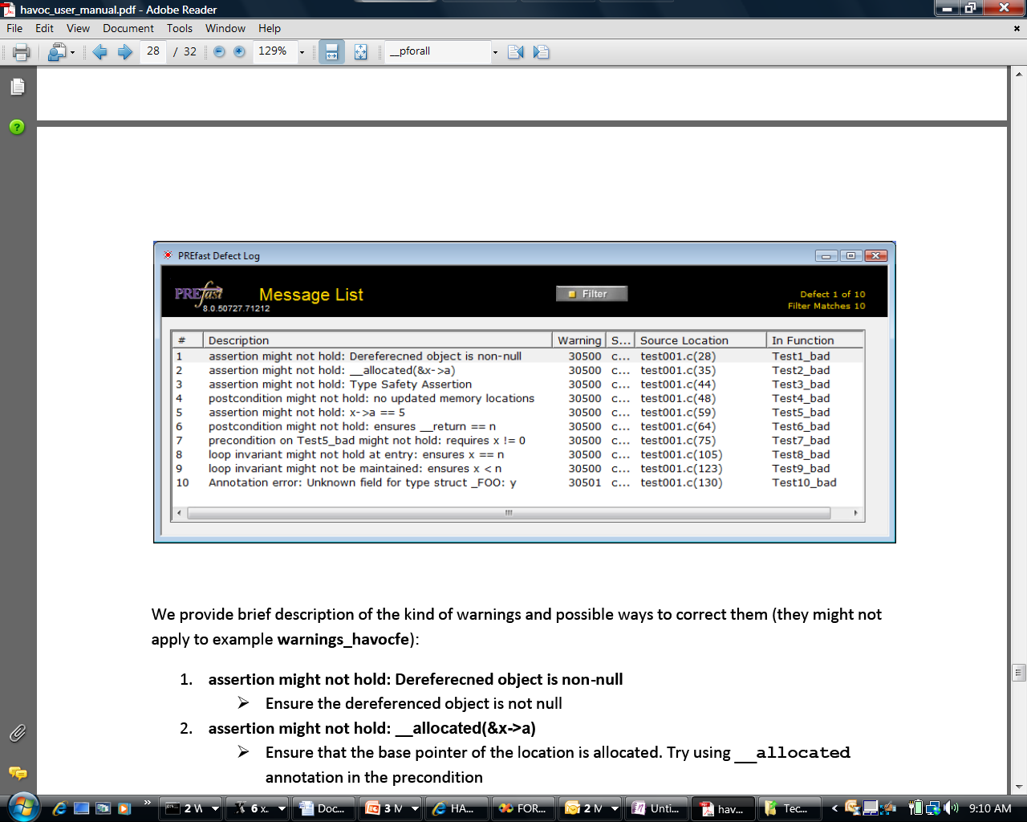
Some Microsoft Engines using Z3
SDV: The Static Driver Verifier
PREfix: The Static Analysis Engine for C/C++.
Pex: Program EXploration for .NET.
SAGE: Scalable Automated Guided Execution
Spec#: C# + contracts
VCC: Verifying C Compiler for the Viridian Hyper-Visor
HAVOC: Heap-Aware Verification of C-code.
SpecExplorer: Model-based testing of protocol specs.
Yogi: Dynamic symbolic execution + abstraction.
FORMULA: Model-based Design
F7: Refinement types for security protocols
Rex: Regular Expressions and formal languages
VS3: Abstract interpretation and Synthesis
VERVE: Verified operating system
FINE: Proof carrying certified code

Slide 40
Test case generation
unsigned GCD(x, y) {
requires(y > 0);
while (true) {
unsigned m = x % y;
if (m == 0) return y;
x = y;
y = m;
}
}
(y₀ > 0) and
(m₀ = x₀ % y₀) and
not (m₀ = 0) and
(x₁ = y₀) and
(y₁ = m₀) and
(m₁ = x₁ % y₁) and
(m₁ = 0)
x₀ = 2
y₀ = 4
m₀ = 2
x₁ = 4
y₁ = 2
m₁ = 0
SSA
Solver
We want a trace where the loop is executed twice.

Slide 41
Type checking
Signature:
div : int, { x : int | x ≠ 0 } → int
Subtype
Call site:
if a ≤ 1 and a ≤ b then
return div(a, b)
Verification condition
a ≤ 1 and a ≤ b implies b ≠ 0

Slide 42
Summary

Slide 43
When to use SMT solvers
To discharge basic theorems automatically
Larger search problems:
Integration with SAT solver cores enable modern, efficient search algorithms.
When your problem uses common theories: Arithmetic, Arrays, Data-types, bit-vectors.
Mostly ground, but with some support for quantifiers:
Quantifier methods by instantiation Sufficient for program verification problems

Slide 44
Propositional Logic
Formulas: ϕ := p | ϕ₁ ∨ϕ₂ | ϕ₁ ∧ϕ₂ | ¬ϕ₁ | ϕ₁ ⇒ ϕ₂
Examples:
p ∨ q ⇒ q ∨ p
p ∧ ¬q ∧ (¬p ∨ q)
We say p and q are propositional variables.

Slide 45
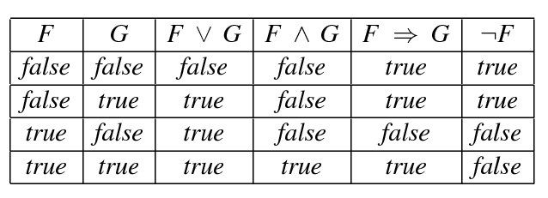
Interpretation
An interpretation M assigns values {true, false} to propositional variables.
Let F and G range over PL formulas.

Slide 46
Satisfiability & Validity
A formula is satisfiable if it has an interpretation that makes it logically true.
In this case, we say the interpretation is a model.
A formula is unsatisfiable if it does not have any model.
A formula is valid if it is logically true in any interpretation.
A propositional formula is valid if and only if its negation is unsatisfiable.

Slide 47
Satisfiability & Validity: examples
p ∨ q ⇒ q ∨ p
p ∨ q ⇒ q
p ∧ ¬q ∧ (¬p ∨ q)

Slide 48
Satisfiability & Validity: examples
p ∨ q ⇒ q ∨ p VALID
p ∨ q ⇒ q SATISFIABLE
p ∧ ¬q ∧ (¬p ∨ q) UNSATISFIABLE

Slide 49
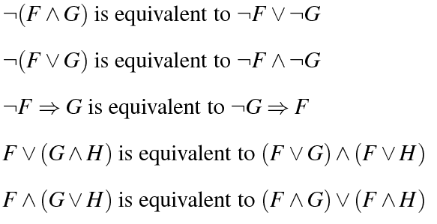
Equivalence
We say two formulas F and G are equivalent if and only if they evaluate to the same value (true or false) in every interpretation

Slide 50
Equisatisfiable
We say formulas A and B are equisatisfiable if and only if A is satisfiable if and only if B is.
During this tutorial, we will describe transformations that preserve equivalence and equisatisfiability.

Slide 51
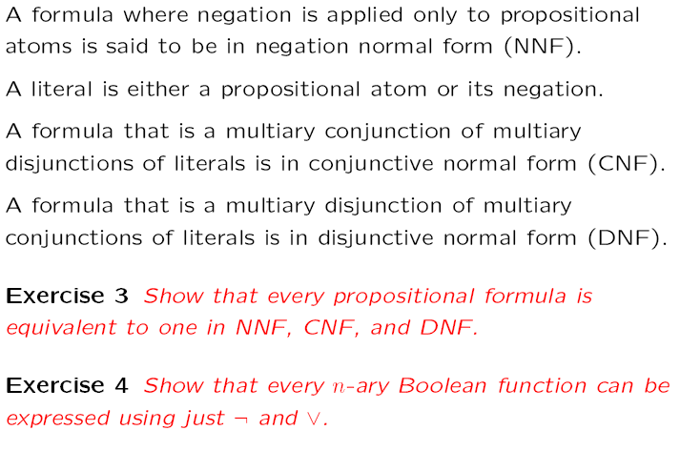
Normal Forms

Slide 52
Normal Forms
NNF?
(p ∨ ¬q) ∧ (q ∨ ¬(r ∧ ¬p))

Slide 53
Normal Forms
NNF? NO
(p ∨ ¬q) ∧ (q ∨ ¬(r ∧ ¬p))

Slide 54
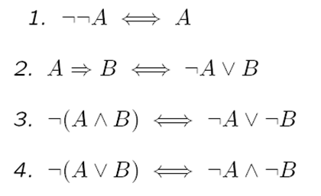
Normal Forms
NNF? NO
(p ∨ ¬q) ∧ (q ∨ ¬(r ∧ ¬p))

Slide 55
Normal Forms
NNF? NO
(p ∨ ¬q) ∧ (q ∨ ¬(r ∧ ¬p))
⇔
(p ∨ ¬q) ∧ (q ∨ (¬r ∨ ¬¬p))

Slide 56
Normal Forms
NNF? NO
(p ∨ ¬q) ∧ (q ∨ ¬(r ∧ ¬p))
⇔
(p ∨ ¬q) ∧ (q ∨ (¬r ∨ ¬¬p))
⇔
(p ∨ ¬q) ∧ (q ∨ (¬r ∨ p))

Slide 57
Normal Forms
CNF?
((p ∧ s) ∨ (¬q ∧ r)) ∧ (q ∨ ¬p ∨ s) ∧ (¬r ∨ s)

Slide 58
Normal Forms
CNF? NO
((p ∧ s) ∨ (¬q ∧ r)) ∧ (q ∨ ¬p ∨ s) ∧ (¬r ∨ s)

Slide 59
Normal Forms
CNF? NO
((p ∧ s) ∨ (¬q ∧ r)) ∧ (q ∨ ¬p ∨ s) ∧ (¬r ∨ s)
Distributivity
1. A∨(B∧C) ⇔ (A∨B)∧(A∨C)
2. A∧(B∨C) ⇔ (A∧B)∨(A∧C)

Slide 60
Normal Forms
CNF? NO
((p ∧ s) ∨ (¬q ∧ r)) ∧ (q ∨ ¬p ∨ s) ∧ (¬r ∨ s)
⇔
((p ∧ s) ∨ ¬q)) ∧ ((p ∧ s) ∨ r)) ∧ (q ∨ ¬p ∨ s) ∧ (¬r ∨ s)
Distributivity
1. A∨(B∧C) ⇔ (A∨B)∧(A∨C)
2. A∧(B∨C) ⇔ (A∧B)∨(A∧C)

Slide 61
Normal Forms
CNF? NO
((p ∧ s) ∨ (¬q ∧ r)) ∧ (q ∨ ¬p ∨ s) ∧ (¬r ∨ s)
⇔
((p ∧ s) ∨ ¬q)) ∧ ((p ∧ s) ∨ r)) ∧ (q ∨ ¬p ∨ s) ∧ (¬r ∨ s)
⇔
(p ∨ ¬q) ∧ (s ∨ ¬q) ∧ ((p ∧ s) ∨ r)) ∧ (q ∨ ¬p ∨ s) ∧ (¬r ∨ s)
Distributivity
1. A∨(B∧C) ⇔ (A∨B)∧(A∨C)
2. A∧(B∨C) ⇔ (A∧B)∨(A∧C)

Slide 62
Normal Forms
CNF? NO
((p ∧ s) ∨ (¬q ∧ r)) ∧ (q ∨ ¬p ∨ s) ∧ (¬r ∨ s)
⇔
((p ∧ s) ∨ ¬q)) ∧ ((p ∧ s) ∨ r)) ∧ (q ∨ ¬p ∨ s) ∧ (¬r ∨ s)
⇔
(p ∨ ¬q) ∧ (s ∨ ¬q) ∧ ((p ∧ s) ∨ r)) ∧ (q ∨ ¬p ∨ s) ∧ (¬r ∨ s)
⇔
(p ∨ ¬q) ∧ (s ∨ ¬q) ∧ (p ∨ r) ∧ (s ∨ r) ∧ (q ∨ ¬p ∨ s) ∧ (¬r ∨ s)

Slide 63
Normal Forms
DNF?
p ∧ (¬p ∨ q) ∧ (¬q ∨ r)

Slide 64
Normal Forms
DNF? NO, actually this formula is in CNF
p ∧ (¬p ∨ q) ∧ (¬q ∨ r)

Slide 65
Normal Forms
DNF? NO, actually this formula is in CNF
p ∧ (¬p ∨ q) ∧ (¬q ∨ r)
Distributivity
1. A∨(B∧C) ⇔ (A∨B)∧(A∨C)
2. A∧(B∨C) ⇔ (A∧B)∨(A∧C)

Slide 66
Normal Forms
DNF? NO, actually this formula is in CNF
p ∧ (¬p ∨ q) ∧ (¬q ∨ r)
⇔
((p ∧ ¬p) ∨ (p ∨ q)) ∧ (¬q ∨ r)
Distributivity
1. A∨(B∧C) ⇔ (A∨B)∧(A∨C)
2. A∧(B∨C) ⇔ (A∧B)∨(A∧C)

Slide 67
Normal Forms
DNF? NO, actually this formula is in CNF
p ∧ (¬p ∨ q) ∧ (¬q ∨ r)
⇔
((p ∧ ¬p) ∨ (p ∨ q)) ∧ (¬q ∨ r)
⇔
(p ∨ q) ∧ (¬q ∨ r)
Distributivity
1. A∨(B∧C) ⇔ (A∨B)∧(A∨C)
2. A∧(B∨C) ⇔ (A∧B)∨(A∧C)
Other Rules
A∧¬A ⇔ ⊥
A∨⊥ ⇔ A

Slide 68
Normal Forms
DNF? NO, actually this formula is in CNF
p ∧ (¬p ∨ q) ∧ (¬q ∨ r)
⇔
((p ∧ ¬p) ∨ (p ∨ q)) ∧ (¬q ∨ r)
⇔
(p ∨ q) ∧ (¬q ∨ r)
⇔
((p ∨ q) ∧ ¬q) ∨ ((p ∨ q) ∧ r)
Distributivity
1. A∨(B∧C) ⇔ (A∨B)∧(A∨C)
2. A∧(B∨C) ⇔ (A∧B)∨(A∧C)
Other Rules
A∧¬A ⇔ ⊥
A∨⊥ ⇔ A

Slide 69
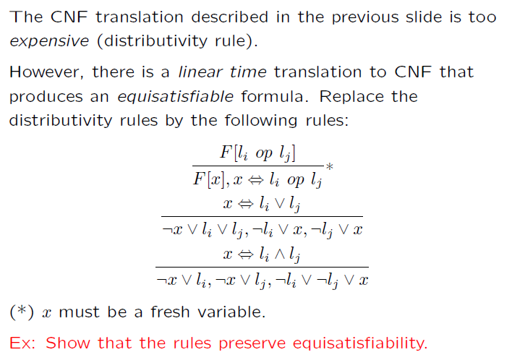
Efficient CNF Translation

Slide 70
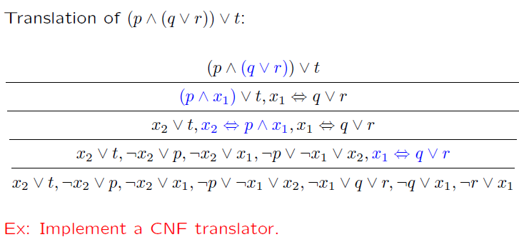
CNF translation (example)

Slide 71
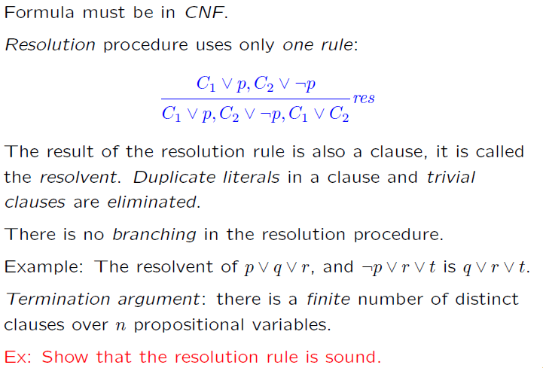
Resolution

Slide 72
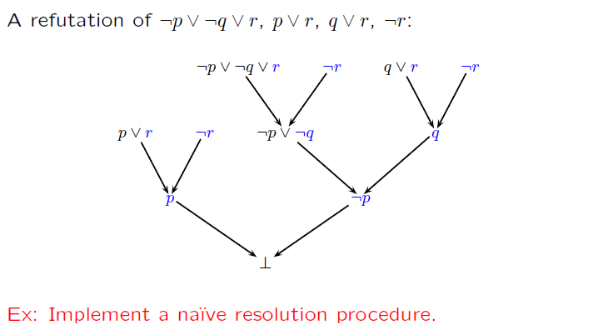
Resolution (example)

Slide 73
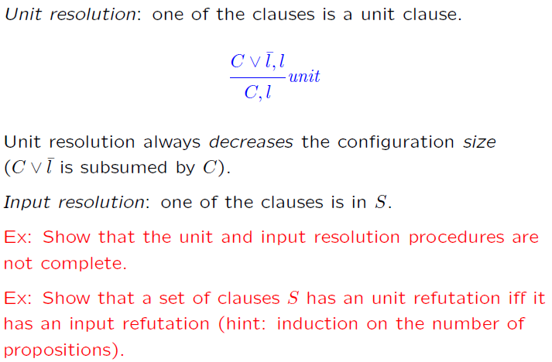
Unit & Input Resolution

Slide 74
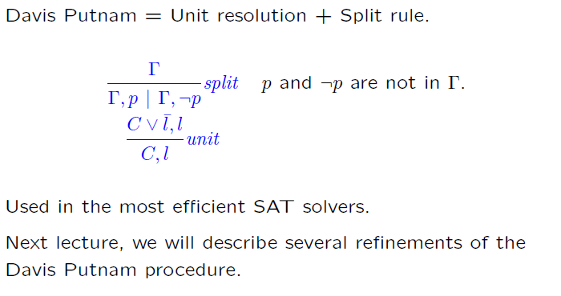
DPLL
DPLL

Slide 75
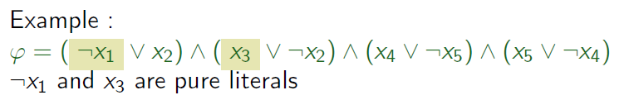
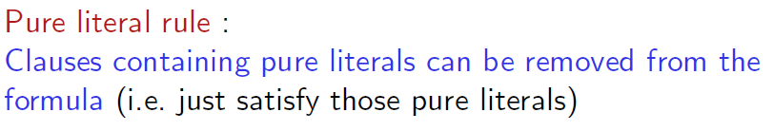
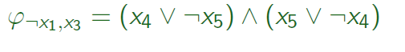
Pure Literals
A literal is pure if only occurs positively or negatively.

Slide 76
Pure Literals
A literal is pure if only occurs positively or negatively.

Slide 77
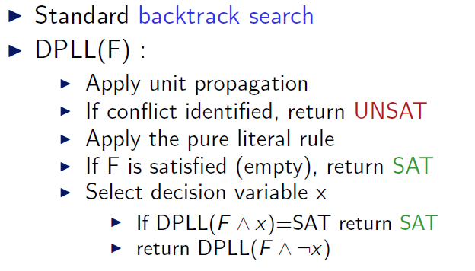
DPLL (as a procedure)

Slide 78
SMT@Microsoft: Solver
Z3 is a new solver developed at Microsoft Research.
Development/Research driven by internal customers.
Free for academic research.
Interfaces:
http://research.microsoft.com/projects/z3
Z3
Text
C/C++
.NET
OCaml

Slide 79
Deciding Equality
a = b, b = c, d = e, b = s, d = t, a≠ e, a≠ s
a
b
c
d
e
s
t

Slide 80
Deciding Equality
a = b, b = c, d = e, b = s, d = t, a≠ e, a≠ s
a
b
c
d
e
s
t

Slide 81
Deciding Equality
a = b, b = c, d = e, b = s, d = t, a≠ e, a≠ s
a,b
c
d
e
s
t

Slide 82
Deciding Equality
a = b, b = c, d = e, b = s, d = t, a≠ e, a≠ s
a,b
c
d
e
s
t

Slide 83
Deciding Equality
a = b, b = c, d = e, b = s, d = t, a≠ e, a≠ s
a,b,c
d
e
s
t

Slide 84
Deciding Equality
a = b, b = c, d = e, b = s, d = t, a≠ e, a≠ s
a,b,c
d
e
s
t

Slide 85
Deciding Equality
a = b, b = c, d = e, b = s, d = t, a≠ e, a≠ s
a,b,c
d,e
s
t

Slide 86
Deciding Equality
a = b, b = c, d = e, b = s, d = t, a≠ e, a≠ s
a,b,c
d,e
s
t

Slide 87
Deciding Equality
a = b, b = c, d = e, b = s, d = t, a≠ e, a≠ s
a,b,c,s
d,e
t

Slide 88
Deciding Equality
a = b, b = c, d = e, b = s, d = t, a≠ e, a≠ s
a,b,c,s
d,e
t

Slide 89
Deciding Equality
a = b, b = c, d = e, b = s, d = t, a≠ e, a≠ s
a,b,c,s
d,e,t

Slide 90
Deciding Equality
a = b, b = c, d = e, b = s, d = t, a≠ e, a≠ s
a,b,c,s
d,e,t

Slide 91
Deciding Equality
a = b, b = c, d = e, b = s, d = t, a≠ e, a≠ s
a,b,c,s
d,e,t
Unsatisfiable

Slide 92
Deciding Equality
a = b, b = c, d = e, b = s, d = t, a≠ e
a,b,c,s
d,e,t
Model construction

Slide 93
Deciding Equality
a = b, b = c, d = e, b = s, d = t, a≠ e
a,b,c,s
♦₁
♦₂
d,e,t
Model construction
|M| = {♦₁ ,♦₂} (universe, aka domain)

Slide 94
Deciding Equality
a = b, b = c, d = e, b = s, d = t, a≠ e
a,b,c,s
♦₁
♦₂
d,e,t
Model construction
|M| = {♦₁ ,♦₂} (universe, aka domain)
M(a) = ♦₁ (assignment)

Slide 95
Deciding Equality
a = b, b = c, d = e, b = s, d = t, a≠ e
a,b,c,s
♦₁
♦₂
d,e,t
Alternative notation:
a^{M} = ♦₁
Model construction
|M| = {♦₁ ,♦₂} (universe, aka domain)
M(a) = ♦₁ (assignment)

Slide 96
Deciding Equality
a = b, b = c, d = e, b = s, d = t, a≠ e
a,b,c,s
♦₁
♦₂
d,e,t
Model construction
|M| = {♦₁ ,♦₂} (universe, aka domain)
M(a) = M(b) = M(c) = M(s) = ♦₁
M(d) = M(e) = M(t) = ♦₂

Slide 97
Deciding Equality: Termination, Soundness, Completeness
Termination: easy
Soundness
Invariant: all constants in a “ball” are known to be equal.
The “ball” merge operation is justified by:
Transitivity and Symmetry rules.
Completeness
We can build a model if an inconsistency was not detected.
Proof template (by contradiction):
Build a candidate model.
Assume a literal was not satisfied.
Find contradiction.

Slide 98
Deciding Equality: Termination, Soundness, Completeness
Completeness
We can build a model if an inconsistency was not detected.
Instantiating the template for our procedure:
Assume some literal c = d is not satisfied by our model.
That is, M(c) ≠ M(d).
This is impossible, c and d must be in the same “ball”.
c,d,…
♦_{i}
M(c) = M(d) = ♦_{i}

Slide 99
Deciding Equality: Termination, Soundness, Completeness
Completeness
We can build a model if an inconsistency was not detected.
Instantiating the template for our procedure:
Assume some literal c ≠ d is not satisfied by our model.
That is, M(c) = M(d).
Key property: we only check the disequalities after we processed all equalities.
This is impossible, c and d must be in the different “balls”
c,…
d,…
♦_{i}
♦_{j}
M(c) = ♦_{i}
M(d) = ♦_{j}

Slide 100
Deciding Equality + (uninterpreted) Functions
a = b, b = c, d = e, b = s, d = t, f(a, g(d)) ≠ f(b, g(e))
Congruence Rule:
x₁ = y₁, …, x_{n} = y_{n} implies f(x₁, …, x_{n}) = f(y₁, …, y_{n})

Slide 101
Deciding Equality + (uninterpreted) Functions
a = b, b = c, d = e, b = s, d = t, f(a, g(d)) ≠ f(b, g(e))
First Step: “Naming” subterms
Congruence Rule:
x₁ = y₁, …, x_{n} = y_{n} implies f(x₁, …, x_{n}) = f(y₁, …, y_{n})

Slide 102
Deciding Equality + (uninterpreted) Functions
a = b, b = c, d = e, b = s, d = t, f(a, v₁) ≠ f(b, g(e))
v₁ ≡ g(d)
First Step: “Naming” subterms
Congruence Rule:
x₁ = y₁, …, x_{n} = y_{n} implies f(x₁, …, x_{n}) = f(y₁, …, y_{n})

Slide 103
Deciding Equality + (uninterpreted) Functions
a = b, b = c, d = e, b = s, d = t, f(a, v₁) ≠ f(b, g(e))
v₁ ≡ g(d)
First Step: “Naming” subterms
Congruence Rule:
x₁ = y₁, …, x_{n} = y_{n} implies f(x₁, …, x_{n}) = f(y₁, …, y_{n})

Slide 104
Deciding Equality + (uninterpreted) Functions
a = b, b = c, d = e, b = s, d = t, f(a, v₁) ≠ f(b, v₂)
v₁ ≡ g(d), v₂ ≡ g(e)
First Step: “Naming” subterms
Congruence Rule:
x₁ = y₁, …, x_{n} = y_{n} implies f(x₁, …, x_{n}) = f(y₁, …, y_{n})

Slide 105
Deciding Equality + (uninterpreted) Functions
a = b, b = c, d = e, b = s, d = t, f(a, v₁) ≠ f(b, v₂)
v₁ ≡ g(d), v₂ ≡ g(e)
First Step: “Naming” subterms
Congruence Rule:
x₁ = y₁, …, x_{n} = y_{n} implies f(x₁, …, x_{n}) = f(y₁, …, y_{n})

Slide 106
Deciding Equality + (uninterpreted) Functions
a = b, b = c, d = e, b = s, d = t, v₃ ≠ f(b, v₂)
v₁ ≡ g(d), v₂ ≡ g(e), v₃ ≡ f(a, v₁)
First Step: “Naming” subterms
Congruence Rule:
x₁ = y₁, …, x_{n} = y_{n} implies f(x₁, …, x_{n}) = f(y₁, …, y_{n})

Slide 107
Deciding Equality + (uninterpreted) Functions
a = b, b = c, d = e, b = s, d = t, v₃ ≠ f(b, v₂)
v₁ ≡ g(d), v₂ ≡ g(e), v₃ ≡ f(a, v₁)
First Step: “Naming” subterms
Congruence Rule:
x₁ = y₁, …, x_{n} = y_{n} implies f(x₁, …, x_{n}) = f(y₁, …, y_{n})

Slide 108
Deciding Equality + (uninterpreted) Functions
a = b, b = c, d = e, b = s, d = t, v₃ ≠ v₄
v₁ ≡ g(d), v₂ ≡ g(e), v₃ ≡ f(a, v₁) , v₄ ≡ f(b, v₂)
First Step: “Naming” subterms
Congruence Rule:
x₁ = y₁, …, x_{n} = y_{n} implies f(x₁, …, x_{n}) = f(y₁, …, y_{n})

Slide 109
Deciding Equality + (uninterpreted) Functions
a = b, b = c, d = e, b = s, d = t, v₃ ≠ v₄
v₁ ≡ g(d), v₂ ≡ g(e), v₃ ≡ f(a, v₁) , v₄ ≡ f(b, v₂)
a,b,c,s
d,e,t
v₁
v₂
v₃
v₄
Congruence Rule:
x₁ = y₁, …, x_{n} = y_{n} implies f(x₁, …, x_{n}) = f(y₁, …, y_{n})

Slide 110
Deciding Equality + (uninterpreted) Functions
a = b, b = c, d = e, b = s, d = t, v₃ ≠ v₄
v₁ ≡ g(d), v₂ ≡ g(e), v₃ ≡ f(a, v₁) , v₄ ≡ f(b, v₂)
a,b,c,s
d,e,t
v₁
v₂
v₃
v₄
Congruence Rule:
x₁ = y₁, …, x_{n} = y_{n} implies f(x₁, …, x_{n}) = f(y₁, …, y_{n})
d = e implies g(d) = g(e)

Slide 111
Deciding Equality + (uninterpreted) Functions
a = b, b = c, d = e, b = s, d = t, v₃ ≠ v₄
v₁ ≡ g(d), v₂ ≡ g(e), v₃ ≡ f(a, v₁) , v₄ ≡ f(b, v₂)
a,b,c,s
d,e,t
v₁
v₂
v₃
v₄
Congruence Rule:
x₁ = y₁, …, x_{n} = y_{n} implies f(x₁, …, x_{n}) = f(y₁, …, y_{n})
d = e implies v₁ = v₂

Slide 112
Deciding Equality + (uninterpreted) Functions
We say:
v₁ and v₂ are congruent.
a = b, b = c, d = e, b = s, d = t, v₃ ≠ v₄
v₁ ≡ g(d), v₂ ≡ g(e), v₃ ≡ f(a, v₁) , v₄ ≡ f(b, v₂)
a,b,c,s
v₁,v₂
d,e,t
v₃
v₄
Congruence Rule:
x₁ = y₁, …, x_{n} = y_{n} implies f(x₁, …, x_{n}) = f(y₁, …, y_{n})
d = e implies v₁ = v₂

Slide 113
Deciding Equality + (uninterpreted) Functions
a = b, b = c, d = e, b = s, d = t, v₃ ≠ v₄
v₁ ≡ g(d), v₂ ≡ g(e), v₃ ≡ f(a, v₁) , v₄ ≡ f(b, v₂)
a,b,c,s
v₁,v₂
d,e,t
v₃
v₄
Congruence Rule:
x₁ = y₁, …, x_{n} = y_{n} implies f(x₁, …, x_{n}) = f(y₁, …, y_{n})
a = b, v₁ = v₂ implies f(a, v₁) = f(b, v₂)

Slide 114
Deciding Equality + (uninterpreted) Functions
a = b, b = c, d = e, b = s, d = t, v₃ ≠ v₄
v₁ ≡ g(d), v₂ ≡ g(e), v₃ ≡ f(a, v₁) , v₄ ≡ f(b, v₂)
a,b,c,s
v₁,v₂
d,e,t
v₃
v₄
Congruence Rule:
x₁ = y₁, …, x_{n} = y_{n} implies f(x₁, …, x_{n}) = f(y₁, …, y_{n})
a = b, v₁ = v₂ implies v₃ = v₄

Slide 115
Deciding Equality + (uninterpreted) Functions
a = b, b = c, d = e, b = s, d = t, v₃ ≠ v₄
v₁ ≡ g(d), v₂ ≡ g(e), v₃ ≡ f(a, v₁) , v₄ ≡ f(b, v₂)
a,b,c,s
v₁,v₂
d,e,t
v_{3,}v₄
Congruence Rule:
x₁ = y₁, …, x_{n} = y_{n} implies f(x₁, …, x_{n}) = f(y₁, …, y_{n})
a = b, v₁ = v₂ implies v₃ = v₄

Slide 116
Deciding Equality + (uninterpreted) Functions
a = b, b = c, d = e, b = s, d = t, v₃ ≠ v₄
v₁ ≡ g(d), v₂ ≡ g(e), v₃ ≡ f(a, v₁) , v₄ ≡ f(b, v₂)
a,b,c,s
v₁,v₂
d,e,t
v_{3,}v₄
Unsatisfiable
Congruence Rule:
x₁ = y₁, …, x_{n} = y_{n} implies f(x₁, …, x_{n}) = f(y₁, …, y_{n})

Slide 117
Deciding Equality + (uninterpreted) Functions
a = b, b = c, d = e, b = s, d = t, a ≠ v₄, v₂ ≠ v₃
v₁ ≡ g(d), v₂ ≡ g(e), v₃ ≡ f(a, v₁) , v₄ ≡ f(b, v₂)
Changing the problem
a,b,c,s
v₁,v₂
d,e,t
v_{3,}v₄
Congruence Rule:
x₁ = y₁, …, x_{n} = y_{n} implies f(x₁, …, x_{n}) = f(y₁, …, y_{n})

Slide 118
Deciding Equality + (uninterpreted) Functions
a = b, b = c, d = e, b = s, d = t, a ≠ v₄, v₂ ≠ v₃
v₁ ≡ g(d), v₂ ≡ g(e), v₃ ≡ f(a, v₁) , v₄ ≡ f(b, v₂)
a,b,c,s
v₁,v₂
d,e,t
v_{3,}v₄
Congruence Rule:
x₁ = y₁, …, x_{n} = y_{n} implies f(x₁, …, x_{n}) = f(y₁, …, y_{n})

Slide 119
Deciding Equality + (uninterpreted) Functions
a = b, b = c, d = e, b = s, d = t, a ≠ v₄, v₂ ≠ v₃
v₁ ≡ g(d), v₂ ≡ g(e), v₃ ≡ f(a, v₁) , v₄ ≡ f(b, v₂)
a,b,c,s
v₁,v₂
d,e,t
v_{3,}v₄
Congruence Rule:
x₁ = y₁, …, x_{n} = y_{n} implies f(x₁, …, x_{n}) = f(y₁, …, y_{n})

Slide 120
Deciding Equality + (uninterpreted) Functions
a = b, b = c, d = e, b = s, d = t, a ≠ v₄, v₂ ≠ v₃
v₁ ≡ g(d), v₂ ≡ g(e), v₃ ≡ f(a, v₁) , v₄ ≡ f(b, v₂)
a,b,c,s
v₁,v₂
♦₁
♦₂
♦₃
♦₄
d,e,t
v_{3,}v₄
Model construction:
|M| = {♦₁ ,♦₂ ,♦₃ ,♦₄}
M(a) = M(b) = M(c) = M(s) = ♦₁
M(d) = M(e) = M(t) = ♦₂
M(v₁) = M(v₂) = ♦₃
M(v₃) = M(v₄) = ♦₄

Slide 121
Deciding Equality + (uninterpreted) Functions
a = b, b = c, d = e, b = s, d = t, a ≠ v₄, v₂ ≠ v₃
v₁ ≡ g(d), v₂ ≡ g(e), v₃ ≡ f(a, v₁) , v₄ ≡ f(b, v₂)
a,b,c,s
v₁,v₂
♦₁
♦₂
♦₃
♦₄
d,e,t
v_{3,}v₄
Model construction:
|M| = {♦₁ ,♦₂ ,♦₃ ,♦₄}
M(a) = M(b) = M(c) = M(s) = ♦₁
M(d) = M(e) = M(t) = ♦₂
M(v₁) = M(v₂) = ♦₃
M(v₃) = M(v₄) = ♦₄
Missing:
Interpretation for f and g.

Slide 122
Deciding Equality + (uninterpreted) Functions
Building the interpretation for function symbols
M(g) is a mapping from |M| to |M|
Defined as:
M(g)(♦_{i}) = ♦_{j} if there is v ≡ g(a) s.t.
M(a) = ♦_{i}
M(v) = ♦_{j}
= ♦_{k}, otherwise (♦_{k} is an arbitrary element)
Is M(g) well-defined?

Slide 123
Deciding Equality + (uninterpreted) Functions
Building the interpretation for function symbols
M(g) is a mapping from |M| to |M|
Defined as:
M(g)(♦_{i}) = ♦_{j} if there is v ≡ g(a) s.t.
M(a) = ♦_{i}
M(v) = ♦_{j}
= ♦_{k}, otherwise (♦_{k} is an arbitrary element)
Is M(g) well-defined?
Problem: we may have
v ≡ g(a) and w ≡ g(b) s.t.
M(a) = M(b) = ♦₁ and M(v) = ♦₂ ≠ ♦₃ = M(w)
So, is M(g)(♦₁) = ♦₂ or M(g)(♦₁) = ♦₃?

Slide 124
Deciding Equality + (uninterpreted) Functions
Building the interpretation for function symbols
M(g) is a mapping from |M| to |M|
Defined as:
M(g)(♦_{i}) = ♦_{j} if there is v ≡ g(a) s.t.
M(a) = ♦_{i}
M(v) = ♦_{j}
= ♦_{k}, otherwise (♦_{k} is an arbitrary element)
Is M(g) well-defined?
Problem: we may have
v ≡ g(a) and w ≡ g(b) s.t.
M(a) = M(b) = ♦₁ and M(v) = ♦₂ ≠ ♦₃ = M(w)
So, is M(g)(♦₁) = ♦₂ or M(g)(♦₁) = ♦₃?
This is impossible because of the congruence rule!
a and b are in the same “ball”, then so are v and w

Slide 125
Deciding Equality + (uninterpreted) Functions
a = b, b = c, d = e, b = s, d = t, a ≠ v₄, v₂ ≠ v₃
v₁ ≡ g(d), v₂ ≡ g(e), v₃ ≡ f(a, v₁) , v₄ ≡ f(b, v₂)
a,b,c,s
v₁,v₂
♦₁
♦₂
♦₃
♦₄
d,e,t
v_{3,}v₄
Model construction:
|M| = {♦₁ ,♦₂ ,♦₃ ,♦₄}
M(a) = M(b) = M(c) = M(s) = ♦₁
M(d) = M(e) = M(t) = ♦₂
M(v₁) = M(v₂) = ♦₃
M(v₃) = M(v₄) = ♦₄

Slide 126
Deciding Equality + (uninterpreted) Functions
a = b, b = c, d = e, b = s, d = t, a ≠ v₄, v₂ ≠ v₃
v₁ ≡ g(d), v₂ ≡ g(e), v₃ ≡ f(a, v₁) , v₄ ≡ f(b, v₂)
Model construction:
|M| = {♦₁ ,♦₂ ,♦₃ ,♦₄}
M(a) = M(b) = M(c) = M(s) = ♦₁
M(d) = M(e) = M(t) = ♦₂
M(v₁) = M(v₂) = ♦₃
M(v₃) = M(v₄) = ♦₄
M(g)(♦_{i}) = ♦_{j} if there is v ≡ g(a) s.t.
M(a) = ♦_{i}
M(v) = ♦_{j}
= ♦_{k}, otherwise

Slide 127
Deciding Equality + (uninterpreted) Functions
a = b, b = c, d = e, b = s, d = t, a ≠ v₄, v₂ ≠ v₃
v₁ ≡ g(d), v₂ ≡ g(e), v₃ ≡ f(a, v₁) , v₄ ≡ f(b, v₂)
Model construction:
|M| = {♦₁ ,♦₂ ,♦₃ ,♦₄}
M(a) = M(b) = M(c) = M(s) = ♦₁
M(d) = M(e) = M(t) = ♦₂
M(v₁) = M(v₂) = ♦₃
M(v₃) = M(v₄) = ♦₄
M(g) = {♦₂ →♦₃}
M(g)(♦_{i}) = ♦_{j} if there is v ≡ g(a) s.t.
M(a) = ♦_{i}
M(v) = ♦_{j}
= ♦_{k}, otherwise

Slide 128
Deciding Equality + (uninterpreted) Functions
a = b, b = c, d = e, b = s, d = t, a ≠ v₄, v₂ ≠ v₃
v₁ ≡ g(d), v₂ ≡ g(e), v₃ ≡ f(a, v₁) , v₄ ≡ f(b, v₂)
Model construction:
|M| = {♦₁ ,♦₂ ,♦₃ ,♦₄}
M(a) = M(b) = M(c) = M(s) = ♦₁
M(d) = M(e) = M(t) = ♦₂
M(v₁) = M(v₂) = ♦₃
M(v₃) = M(v₄) = ♦₄
M(g) = {♦₂ →♦₃}
M(g)(♦_{i}) = ♦_{j} if there is v ≡ g(a) s.t.
M(a) = ♦_{i}
M(v) = ♦_{j}
= ♦_{k}, otherwise

Slide 129
Deciding Equality + (uninterpreted) Functions
a = b, b = c, d = e, b = s, d = t, a ≠ v₄, v₂ ≠ v₃
v₁ ≡ g(d), v₂ ≡ g(e), v₃ ≡ f(a, v₁) , v₄ ≡ f(b, v₂)
Model construction:
|M| = {♦₁ ,♦₂ ,♦₃ ,♦₄}
M(a) = M(b) = M(c) = M(s) = ♦₁
M(d) = M(e) = M(t) = ♦₂
M(v₁) = M(v₂) = ♦₃
M(v₃) = M(v₄) = ♦₄
M(g) = {♦₂ →♦₃, else →♦₁}
M(g)(♦_{i}) = ♦_{j} if there is v ≡ g(a) s.t.
M(a) = ♦_{i}
M(v) = ♦_{j}
= ♦_{k}, otherwise

Slide 130
Deciding Equality + (uninterpreted) Functions
a = b, b = c, d = e, b = s, d = t, a ≠ v₄, v₂ ≠ v₃
v₁ ≡ g(d), v₂ ≡ g(e), v₃ ≡ f(a, v₁) , v₄ ≡ f(b, v₂)
Model construction:
|M| = {♦₁ ,♦₂ ,♦₃ ,♦₄}
M(a) = M(b) = M(c) = M(s) = ♦₁
M(d) = M(e) = M(t) = ♦₂
M(v₁) = M(v₂) = ♦₃
M(v₃) = M(v₄) = ♦₄
M(g) = {♦₂ →♦₃, else →♦₁}
M(f) = { (♦₁ ,♦₃) →♦₄, else →♦₁}
M(g)(♦_{i}) = ♦_{j} if there is v ≡ g(a) s.t.
M(a) = ♦_{i}
M(v) = ♦_{j}
= ♦_{k}, otherwise

Slide 131
Deciding Equality + (uninterpreted) Functions
What about predicates?
p(a, b), ¬p(c, b)

Slide 132
Deciding Equality + (uninterpreted) Functions
What about predicates?
p(a, b), ¬p(c, b)
f_{p}(a, b) = T, f_{p} (c, b) ≠ T

Slide 133
Deciding Equality + (uninterpreted) Functions
It is possible to implement our procedure in
O(n log n)

Slide 134
Case Analysis
Many verification/analysis problems require: case-analysis
x ≥ 0, y = x + 1, (y > 2 ∨ y < 1)

Slide 135
Case Analysis
Many verification/analysis problems require: case-analysis
x ≥ 0, y = x + 1, (y > 2 ∨ y < 1)
Naïve Solution: Convert to DNF
(x ≥ 0, y = x + 1, y > 2) ∨ (x ≥ 0, y = x + 1, y < 1)

Slide 136
Case Analysis
Many verification/analysis problems require: case-analysis
x ≥ 0, y = x + 1, (y > 2 ∨ y < 1)
Naïve Solution: Convert to DNF
(x ≥ 0, y = x + 1, y > 2) ∨ (x ≥ 0, y = x + 1, y < 1)
Too Inefficient!
(exponential blowup)

Slide 137
SMT : Basic Architecture
SAT
Theory
Solvers
SMT
Equality + UF
Arithmetic
Bit-vectors
…
Case Analysis

Slide 138
DPLL
M | F
Partial model
Set of clauses

Slide 139
DPLL
Guessing
p | p ∨ q, ¬q ∨ r
p, ¬q | p ∨ q, ¬q ∨ r

Slide 140
DPLL
Deducing
p | p ∨ q, ¬p ∨ s
p, s| p ∨ q, ¬p ∨ s

Slide 141
DPLL
Backtracking
p, ¬s, q | p ∨ q, s ∨ q, ¬p∨ ¬q
p, s| p ∨ q, s ∨ q, ¬p∨ ¬q

Slide 142
Modern DPLL
Efficient indexing (two-watch literal)
Non-chronological backtracking (backjumping)
Lemma learning

Slide 143
SAT + Theory solvers
Basic Idea
x ≥ 0, y = x + 1, (y > 2 ∨ y < 1)
Abstract (aka “naming” atoms)
p₁, p₂, (p₃ ∨ p₄)
p₁ ≡ (x ≥ 0), p₂ ≡ (y = x + 1),
p₃ ≡ (y > 2), p₄ ≡ (y < 1)

Slide 144
SAT + Theory solvers
Basic Idea
x ≥ 0, y = x + 1, (y > 2 ∨ y < 1)
Abstract (aka “naming” atoms)
p₁, p₂, (p₃ ∨ p₄)
p₁ ≡ (x ≥ 0), p₂ ≡ (y = x + 1),
p₃ ≡ (y > 2), p₄ ≡ (y < 1)
SAT
Solver

Slide 145
SAT + Theory solvers
Basic Idea
x ≥ 0, y = x + 1, (y > 2 ∨ y < 1)
Abstract (aka “naming” atoms)
p₁, p₂, (p₃ ∨ p₄)
p₁ ≡ (x ≥ 0), p₂ ≡ (y = x + 1),
p₃ ≡ (y > 2), p₄ ≡ (y < 1)
SAT
Solver
Assignment
p₁, p₂, ¬p₃, p₄

Slide 146
SAT + Theory solvers
Basic Idea
x ≥ 0, y = x + 1, (y > 2 ∨ y < 1)
Abstract (aka “naming” atoms)
p₁, p₂, (p₃ ∨ p₄)
p₁ ≡ (x ≥ 0), p₂ ≡ (y = x + 1),
p₃ ≡ (y > 2), p₄ ≡ (y < 1)
SAT
Solver
Assignment
p₁, p₂, ¬p₃, p₄
x ≥ 0, y = x + 1,
¬(y > 2), y < 1

Slide 147
SAT + Theory solvers
Basic Idea
x ≥ 0, y = x + 1, (y > 2 ∨ y < 1)
Abstract (aka “naming” atoms)
p₁, p₂, (p₃ ∨ p₄)
p₁ ≡ (x ≥ 0), p₂ ≡ (y = x + 1),
p₃ ≡ (y > 2), p₄ ≡ (y < 1)
SAT
Solver
Assignment
p₁, p₂, ¬p₃, p₄
x ≥ 0, y = x + 1,
¬(y > 2), y < 1
Unsatisfiable
x ≥ 0, y = x + 1, y < 1
Theory
Solver

Slide 148
SAT + Theory solvers
Basic Idea
x ≥ 0, y = x + 1, (y > 2 ∨ y < 1)
Abstract (aka “naming” atoms)
p₁, p₂, (p₃ ∨ p₄)
p₁ ≡ (x ≥ 0), p₂ ≡ (y = x + 1),
p₃ ≡ (y > 2), p₄ ≡ (y < 1)
SAT
Solver
Assignment
p₁, p₂, ¬p₃, p₄
x ≥ 0, y = x + 1,
¬(y > 2), y < 1
New Lemma
¬p₁∨¬p₂∨¬p₄
Unsatisfiable
x ≥ 0, y = x + 1, y < 1
Theory
Solver

Slide 149
SAT + Theory solvers
New Lemma
¬p₁∨¬p₂∨¬p₄
Unsatisfiable
x ≥ 0, y = x + 1, y < 1
Theory
Solver
AKA
Theory conflict

Slide 150
SAT + Theory solvers: Main loop
procedure SmtSolver(F)
(F_{p}, M) := Abstract(F)
loop
(R, A) := SAT_solver(F_{p})
if R = UNSAT then return UNSAT
S := Concretize(A, M)
(R, S’) := Theory_solver(S)
if R = SAT then return SAT
L := New_Lemma(S’, M)
Add L to F_{p}

Slide 151
SAT + Theory solvers
Basic Idea
F: x ≥ 0, y = x + 1, (y > 2 ∨ y < 1)
Abstract (aka “naming” atoms)
F_{p} : p₁, p₂, (p₃ ∨ p₄)
M: p₁ ≡ (x ≥ 0), p₂ ≡ (y = x + 1),
p₃ ≡ (y > 2), p₄ ≡ (y < 1)
SAT
Solver
A: Assignment
p₁, p₂, ¬p₃, p₄
S: x ≥ 0, y = x + 1,
¬(y > 2), y < 1
L: New Lemma
¬p₁∨¬p₂∨¬p₄
S’: Unsatisfiable
x ≥ 0, y = x + 1, y < 1
Theory
Solver

Slide 152
SAT + Theory solvers
F: x ≥ 0, y = x + 1, (y > 2 ∨ y < 1)
Abstract (aka “naming” atoms)
F_{p} : p₁, p₂, (p₃ ∨ p₄)
M: p₁ ≡ (x ≥ 0), p₂ ≡ (y = x + 1),
p₃ ≡ (y > 2), p₄ ≡ (y < 1)
SAT
Solver
A: Assignment
p₁, p₂, ¬p₃, p₄
S: x ≥ 0, y = x + 1,
¬(y > 2), y < 1
L: New Lemma
¬p₁∨¬p₂∨¬p₄
S’: Unsatisfiable
x ≥ 0, y = x + 1, y < 1
Theory
Solver
procedure SMT_Solver(F)
(F_{p}, M) := Abstract(F)
loop
(R, A) := SAT_solver(F_{p})
if R = UNSAT then return UNSAT
S = Concretize(A, M)
(R, S’) := Theory_solver(S)
if R = SAT then return SAT
L := New_Lemma(S, M)
Add L to F_{p}
“Lazy translation” to
DNF

Slide 153
SAT + Theory solvers
State-of-the-art SMT solvers implement
many improvements.

Slide 154
SAT + Theory solvers
Incrementality
Send the literals to the Theory solver as they are assigned by the SAT solver
p₁ ≡ (x ≥ 0), p₂ ≡ (y = x + 1),
p₃ ≡ (y > 2), p₄ ≡ (y < 1), p₅ ≡ (x < 2),
p₁, p₂, p₄ | p₁, p₂, (p₃ ∨ p₄), (p₅ ∨ ¬p₄)
Partial assignment is already
Theory inconsistent.

Slide 155
SAT + Theory solvers
Efficient Backtracking
We don’t want to restart from scratch after each backtracking operation.

Slide 156
SAT + Theory solvers
Efficient Lemma Generation (computing a small S’)
Avoid lemmas containing redundant literals.
p₁ ≡ (x ≥ 0), p₂ ≡ (y = x + 1),
p₃ ≡ (y > 2), p₄ ≡ (y < 1), p₅ ≡ (x < 2),
p₁, p₂, p₃, p₄ | p₁, p₂, (p₃ ∨ p₄), (p₅ ∨ ¬p₄)
¬p₁∨¬p₂ ∨¬p₃ ∨¬p₄
Imprecise Lemma

Slide 157
SAT + Theory solvers
Theory Propagation
It is the SMT equivalent of unit propagation.
p₁ ≡ (x ≥ 0), p₂ ≡ (y = x + 1),
p₃ ≡ (y > 2), p₄ ≡ (y < 1), p₅ ≡ (x < 2),
p₁, p₂ | p₁, p₂, (p₃ ∨ p₄), (p₅ ∨ ¬p₄)
p₁, p₂ imply ¬p₄ by theory propagation
p₁, p₂ , ¬p₄ | p₁, p₂, (p₃ ∨ p₄), (p₅ ∨ ¬p₄)

Slide 158
SAT + Theory solvers
Theory Propagation
It is the SMT equivalent of unit propagation.
p₁ ≡ (x ≥ 0), p₂ ≡ (y = x + 1),
p₃ ≡ (y > 2), p₄ ≡ (y < 1), p₅ ≡ (x < 2),
p₁, p₂ | p₁, p₂, (p₃ ∨ p₄), (p₅ ∨ ¬p₄)
p₁, p₂ imply ¬p₄ by theory propagation
p₁, p₂ , ¬p₄ | p₁, p₂, (p₃ ∨ p₄), (p₅ ∨ ¬p₄)
Tradeoff between precision × performance.

Slide 159
An Architecture: the core
Core
Arithmetic
Bit-Vectors
Scalar Values
Equality
Uninterpreted Functions
SAT Solver

Slide 160
An Architecture: the core
Core
Arithmetic
Bit-Vectors
Scalar Values
Equality
Uninterpreted Functions
Case Analysis
SAT Solver

Slide 161
An Architecture: the core
Core
Arithmetic
Bit-Vectors
Scalar Values
Equality
Uninterpreted Functions
Blackboard:
equalities, disequalities,
predicates
SAT Solver

Slide 162
Linear Arithmetic
Many approaches
Graph-based for difference logic: a – b ≤ 3
Fourier-Motzkin elimination:
Standard Simplex
General Form Simplex

Slide 163
Difference Logic: a – b ≤ 5
Very useful in practice!
Most arithmetical constraints in software verification/analysis are in this fragment.
x := x + 1
x₁ = x₀ + 1
x₁ - x₀ ≤ 1, x₀ - x₁ ≤ -1

Slide 164
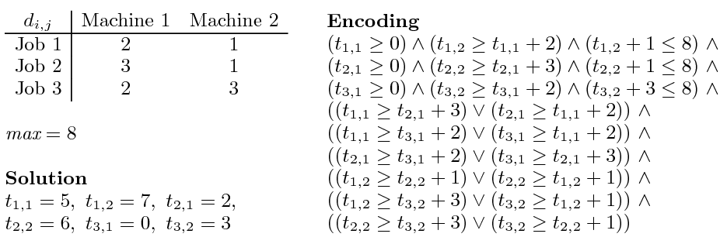
Job shop scheduling

Slide 165
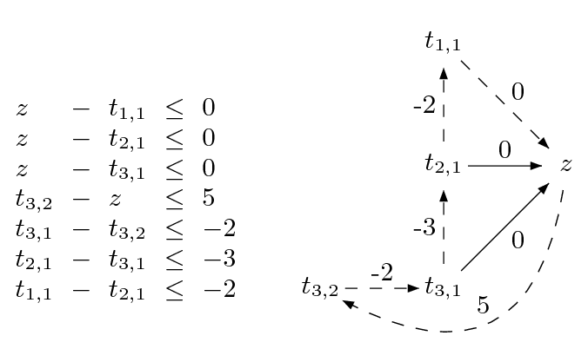
Difference Logic
Chasing negative cycles!
Algorithms based on Bellman-Ford (O(mn)).

Slide 166
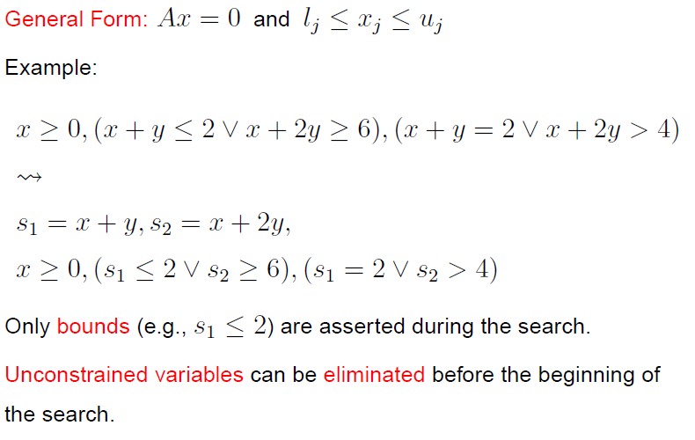
General Form

Slide 167
From Definitions to a Tableau
s₁ ≡ x + y, s₂ ≡ x + 2y

Slide 168
From Definitions to a Tableau
s₁ ≡ x + y, s₂ ≡ x + 2y
s₁ = x + y,
s₂ = x + 2y

Slide 169
From Definitions to a Tableau
s₁ ≡ x + y, s₂ ≡ x + 2y
s₁ = x + y,
s₂ = x + 2y
s₁ - x - y = 0
s₂ - x - 2y = 0

Slide 170
From Definitions to a Tableau
s₁ ≡ x + y, s₂ ≡ x + 2y
s₁ = x + y,
s₂ = x + 2y
s₁ - x - y = 0
s₂ - x - 2y = 0
s₁, s₂ are basic (dependent)
x,y are non-basic

Slide 171
Pivoting
A way to swap a basic with a non-basic variable!
It is just equational reasoning.
Key invariant: a basic variable occurs in only one equation.
Example: swap s₁ and y
s₁ - x - y = 0
s₂ - x - 2y = 0

Slide 172
Pivoting
A way to swap a basic with a non-basic variable!
It is just equational reasoning.
Key invariant: a basic variable occurs in only one equation.
Example: swap s₁ and y
s₁ - x - y = 0
s₂ - x - 2y = 0
-s₁ + x + y = 0
s₂ - x - 2y = 0

Slide 173
Pivoting
A way to swap a basic with a non-basic variable!
It is just equational reasoning.
Key invariant: a basic variable occurs in only one equation.
Example: swap s₁ and y
s₁ - x - y = 0
s₂ - x - 2y = 0
-s₁ + x + y = 0
s₂ - x - 2y = 0
-s₁ + x + y = 0
s₂ - 2s₁ + x = 0

Slide 174
Pivoting
A way to swap a basic with a non-basic variable!
It is just equational reasoning.
Key invariant: a basic variable occurs in only one equation.
Example: swap s₁ and y
It is just substituting equals by equals.
s₁ - x - y = 0
s₂ - x - 2y = 0
-s₁ + x + y = 0
s₂ - x - 2y = 0
-s₁ + x + y = 0
s₂ - 2s₁ + x = 0

Slide 175
Pivoting
Definition:
An assignment (model) is a mapping from variables to values
A way to swap a basic with a non-basic variable!
It is just equational reasoning.
Key invariant: a basic variable occurs in only one equation.
Example: swap s₁ and y
It is just substituting equals by equals.
s₁ - x - y = 0
s₂ - x - 2y = 0
-s₁ + x + y = 0
s₂ - x - 2y = 0
Key Property:
If an assignment satisfies the equations before a pivoting step, then it will also satisfy them after!
-s₁ + x + y = 0
s₂ - 2s₁ + x = 0

Slide 176
Pivoting
Definition:
An assignment (model) is a mapping from variables to values
A way to swap a basic with a non-basic variable!
It is just equational reasoning.
Key invariant: a basic variable occurs in only one equation.
Example: swap s₂ and y
It is just substituting equals by equals.
s₁ - x - y = 0
s₂ - x - 2y = 0
Example:
M(x) = 1
M(y) = 1
M(s₁) = 2
M(s₂) = 3
-s₁ + x + y = 0
s₂ - x - 2y = 0
Key Property:
If an assignment satisfies the equations before a pivoting step, then it will also satisfy them after!
-s₁ + x + y = 0
s₂ - 2s₁ + x = 0

Slide 177
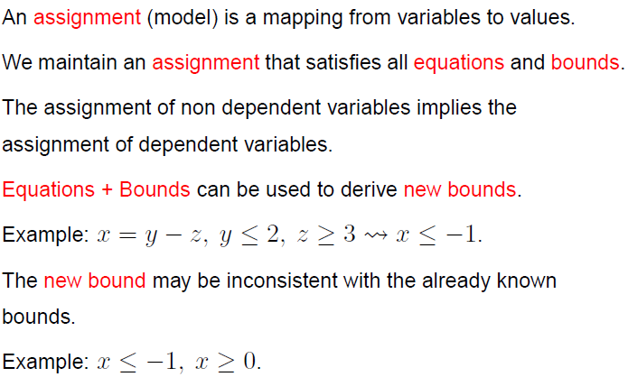
Equations + Bounds + Assignment

Slide 178
“Repairing Models”
If the assignment of a non-basic variable does not satisfy a bound, then fix it and propagate the change to all dependent variables.
a = c – d
b = c + d
M(a) = 0
M(b) = 0
M(c) = 0
M(d) = 0
1 ≤ c
a = c – d
b = c + d
M(a) = 1
M(b) = 1
M(c) = 1
M(d) = 0
1 ≤ c

Slide 179
“Repairing Models”
If the assignment of a non-basic variable does not satisfy a bound, then fix it and propagate the change to all dependent variables. Of course, we may introduce new “problems”.
a = c – d
b = c + d
M(a) = 0
M(b) = 0
M(c) = 0
M(d) = 0
1 ≤ c
a ≤ 0
a = c – d
b = c + d
M(a) = 1
M(b) = 1
M(c) = 1
M(d) = 0
1 ≤ c
a ≤ 0

Slide 180
“Repairing Models”
If the assignment of a basic variable does not satisfy a bound, then pivot it, fix it, and propagate the change to its new dependent variables.
a = c – d
b = c + d
M(a) = 0
M(b) = 0
M(c) = 0
M(d) = 0
1 ≤ a
c = a + d
b = a + 2d
M(a) = 0
M(b) = 0
M(c) = 0
M(d) = 0
1 ≤ a
c = a + d
b = a + 2d
M(a) = 1
M(b) = 1
M(c) = 1
M(d) = 0
1 ≤ a

Slide 181
“Repairing Models”
Sometimes, a model cannot be repaired. It is pointless to pivot.
a = b – c
a ≤ 0, 1 ≤ b, c ≤ 0
M(a) = 1
M(b) = 1
M(c) = 0
The value of M(a) is too big. We can reduce it by:
reducing M(b)
not possible b is at lower bound
increasing M(c)
not possible c is at upper bound

Slide 182
“Repairing Models”
Extracting proof from failed repair attempts is easy.
s₁ ≡ a + d, s₂ ≡ c + d
a = s₁ – s₂ + c
a ≤ 0, 1 ≤ s₁, s₂ ≤ 0, 0 ≤ c
M(a) = 1
M(s₁) = 1
M(s₂) = 0
M(c) = 0

Slide 183
“Repairing Models”
Extracting proof from failed repair attempts is easy.
s₁ ≡ a + d, s₂ ≡ c + d
a = s₁ – s₂ + c
a ≤ 0, 1 ≤ s₁, s₂ ≤ 0, 0 ≤ c
M(a) = 1
M(s₁) = 1
M(s₂) = 0
M(c) = 0
{ a ≤ 0, 1 ≤ s₁, s₂ ≤ 0, 0 ≤ c } is inconsistent

Slide 184
“Repairing Models”
Extracting proof from failed repair attempts is easy.
s₁ ≡ a + d, s₂ ≡ c + d
a = s₁ – s₂ + c
a ≤ 0, 1 ≤ s₁, s₂ ≤ 0, 0 ≤ c
M(a) = 1
M(s₁) = 1
M(s₂) = 0
M(c) = 0
{ a ≤ 0, 1 ≤ s₁, s₂ ≤ 0, 0 ≤ c } is inconsistent
{ a ≤ 0, 1 ≤ a + d, c + d ≤ 0, 0 ≤ c } is inconsistent

Slide 185
Combining Theories
In practice, we need a combination of theories.
b + 2 = c and f(read(write(a,b,3), c-2)) ≠ f(c-b+1)
A theory is a set (potentially infinite) of first-order sentences.
Main questions:
Is the union of two theories T1 ∪ T2 consistent?
Given a solvers for T1 and T2, how can we build a solver for
T1 ∪ T2?

Slide 186
Disjoint Theories
Two theories are disjoint if they do not share function/constant and predicate symbols.
= is the only exception.
Example:
The theories of arithmetic and arrays are disjoint.
Arithmetic symbols: {0, -1, 1, -2, 2, …, +, -, *, >, <, ≥, ≤}
Array symbols: { read, write }

Slide 187
Purification
It is a different name for our “naming” subterms procedure.
b + 2 = c, f(read(write(a,b,3), c-2)) ≠ f(c-b+1)
b + 2 = c, v₆ ≠ v₇
v₁ ≡ 3, v₂ ≡ write(a, b, v₁), v₃ ≡ c-2, v₄ ≡ read(v₂, v₃),
v₅ ≡ c-b+1, v₆ ≡ f(v₄), v₇ ≡ f(v₅)

Slide 188
Purification
It is a different name for our “naming” subterms procedure.
b + 2 = c, f(read(write(a,b,3), c-2)) ≠ f(c-b+1)
b + 2 = c, v₆ ≠ v₇
v₁ ≡ 3, v₂ ≡ write(a, b, v₁), v₃ ≡ c-2, v₄ ≡ read(v₂, v₃),
v₅ ≡ c-b+1, v₆ ≡ f(v₄), v₇ ≡ f(v₅)
b + 2 = c, v₁ ≡ 3, v₃ ≡ c-2, v₅ ≡ c-b+1,
v₂ ≡ write(a, b, v₁), v₄ ≡ read(v₂, v₃),
v₆ ≡ f(v₄), v₇ ≡ f(v₅), v₆ ≠ v₇

Slide 189
Stably Infinite Theories
A theory is stably infinite if every satisfiable QFF is satisfiable in an infinite model.
EUF and arithmetic are stably infinite.
Bit-vectors are not.

Slide 190
Important Result
The union of two consistent, disjoint, stably infinite theories is consistent.

Slide 191
Convexity
A theory T is convex iff
for all finite sets S of literals and
for all a₁ = b₁∨ … ∨ a_{n} = b_{n}
S implies a₁ = b₁∨ … ∨ a_{n} = b_{n}
iff
S implies a_{i} = b_{i} for some 1 ≤ i ≤ n

Slide 192
Convexity: Results
Every convex theory with non trivial models is stably infinite.
All Horn equational theories are convex.
formulas of the form s₁ ≠ r₁∨ … ∨ s_{n} ≠ r_{n} ∨ t = t’
Linear rational arithmetic is convex.

Slide 193
Convexity: Negative Results
Linear integer arithmetic is not convex
1 ≤ a ≤ 2, b = 1, c = 2 implies a = b ∨ a = c
Nonlinear arithmetic
a² = 1, b = 1, c = -1 implies a = b ∨ a = c
Theory of bit-vectors
Theory of arrays
c₁ = read(write(a, i, c₂), j), c₃ = read(a, j)
implies c₁ = c₂ ∨ c₁ = c₃

Slide 194
Combination of non-convex theories
EUF is convex (O(n log n))
IDL is non-convex (O(nm))
EUF ∪ IDL is NP-Complete
Reduce 3CNF to EUF ∪ IDL
For each boolean variable p_{i} add 0 ≤ a_{i} ≤ 1
For each clause p₁ ∨ ¬p₂ ∨ p₃ add
f(a₁, a₂, a₃) ≠ f(0, 1, 0)

Slide 195
Combination of non-convex theories
EUF is convex (O(n log n))
IDL is non-convex (O(nm))
EUF ∪ IDL is NP-Complete
Reduce 3CNF to EUF ∪ IDL
For each boolean variable p_{i} add 0 ≤ a_{i} ≤ 1
For each clause p₁ ∨ ¬p₂ ∨ p₃ add
f(a₁, a₂, a₃) ≠ f(0, 1, 0)
implies
a₁ ≠ 0 ∨ a₂ ≠ 1 ∨ a₃ ≠ 0

Slide 196
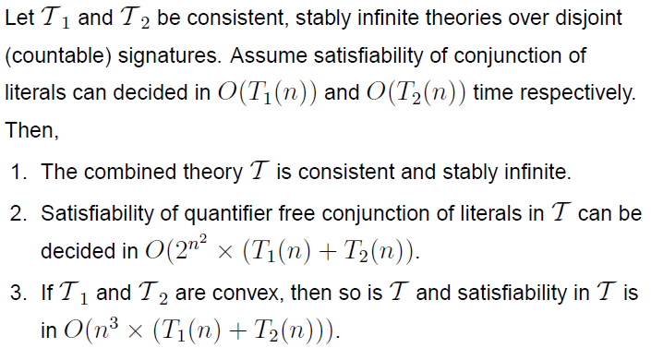
Nelson-Oppen Combination

Slide 197
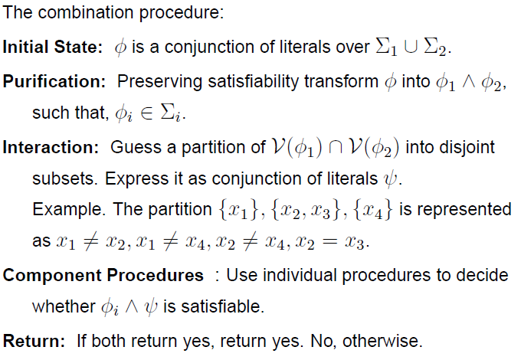
Nelson-Oppen Combination

Slide 198
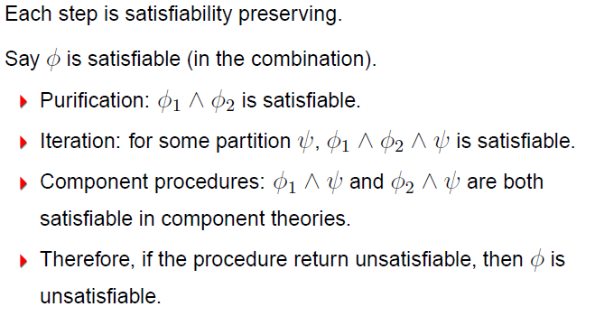
Soundness

Slide 199
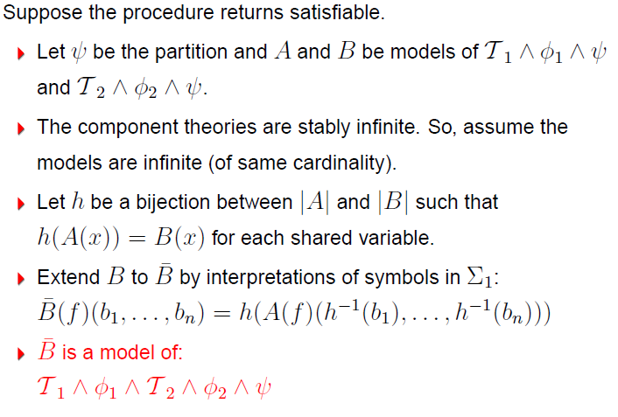
Completeness

Slide 200
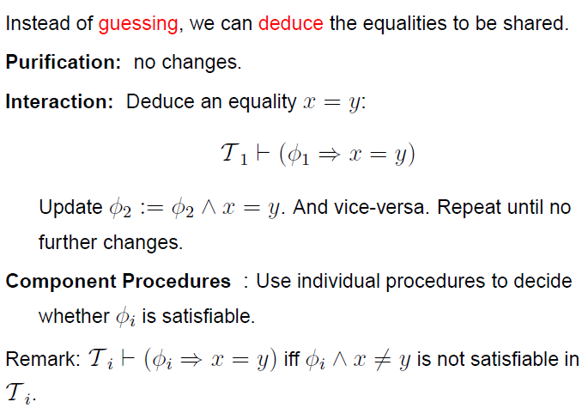
NO deterministic procedure (for convex theories)

Slide 201
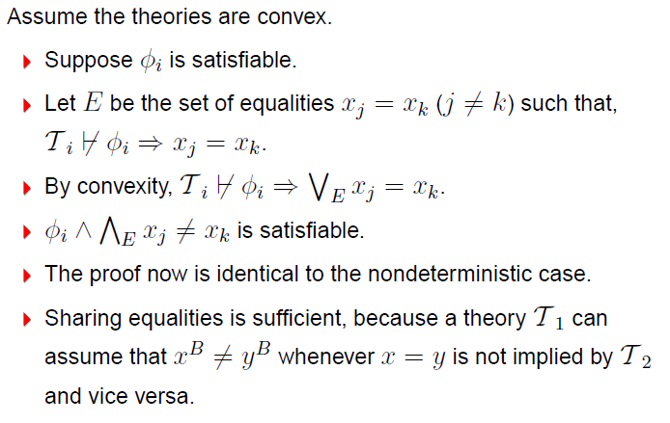
NO deterministic procedure Completeness

Slide 202
NO procedure: Example
b + 2 = c, f(read(write(a,b,3), c-2)) ≠ f(c-b+1)
Arithmetic
b + 2 = c,
v₁ ≡ 3,
v₃ ≡ c-2,
v₅ ≡ c-b+1
Arrays
v₂ ≡ write(a, b, v₁), v₄ ≡ read(v₂, v₃)
EUF
v₆ ≡ f(v₄),
v₇ ≡ f(v₅),
v₆ ≠ v₇

Slide 203
NO procedure: Example
b + 2 = c, f(read(write(a,b,3), c-2)) ≠ f(c-b+1)
Arithmetic
b + 2 = c,
v₁ ≡ 3,
v₃ ≡ c-2,
v₅ ≡ c-b+1
Arrays
v₂ ≡ write(a, b, v₁), v₄ ≡ read(v₂, v₃)
EUF
v₆ ≡ f(v₄),
v₇ ≡ f(v₅),
v₆ ≠ v₇
Substituting c

Slide 204
NO procedure: Example
b + 2 = c, f(read(write(a,b,3), c-2)) ≠ f(c-b+1)
Arithmetic
b + 2 = c,
v₁ ≡ 3,
v₃ ≡ b,
v₅ ≡ 3
Arrays
v₂ ≡ write(a, b, v₁), v₄ ≡ read(v₂, v₃),
EUF
v₆ ≡ f(v₄),
v₇ ≡ f(v₅),
v₆ ≠ v₇
Propagating v₃ = b

Slide 205
NO procedure: Example
b + 2 = c, f(read(write(a,b,3), c-2)) ≠ f(c-b+1)
Arithmetic
b + 2 = c,
v₁ ≡ 3,
v₃ ≡ b,
v₅ ≡ 3
Arrays
v₂ ≡ write(a, b, v₁), v₄ ≡ read(v₂, v₃),
v₃ = b
EUF
v₆ ≡ f(v₄),
v₇ ≡ f(v₅),
v₆ ≠ v₇,
v₃ = b
Deducing v₄ = v₁

Slide 206
NO procedure: Example
b + 2 = c, f(read(write(a,b,3), c-2)) ≠ f(c-b+1)
Arithmetic
b + 2 = c,
v₁ ≡ 3,
v₃ ≡ b,
v₅ ≡ 3
Arrays
v₂ ≡ write(a, b, v₁), v₄ ≡ read(v₂, v₃),
v₃ = b,
v₄ = v₁
EUF
v₆ ≡ f(v₄),
v₇ ≡ f(v₅),
v₆ ≠ v₇,
v₃ = b
Propagating v₄ = v₁

Slide 207
NO procedure: Example
b + 2 = c, f(read(write(a,b,3), c-2)) ≠ f(c-b+1)
Arithmetic
b + 2 = c,
v₁ ≡ 3,
v₃ ≡ b,
v₅ ≡ 3,
v₄ = v₁
Arrays
v₂ ≡ write(a, b, v₁), v₄ ≡ read(v₂, v₃),
v₃ = b,
v₄ = v₁
EUF
v₆ ≡ f(v₄),
v₇ ≡ f(v₅),
v₆ ≠ v₇,
v₃ = b,
v₄ = v₁
Propagating v₅ = v₁

Slide 208
NO procedure: Example
b + 2 = c, f(read(write(a,b,3), c-2)) ≠ f(c-b+1)
Arithmetic
b + 2 = c,
v₁ ≡ 3,
v₃ ≡ b,
v₅ ≡ 3,
v₄ = v₁
Arrays
v₂ ≡ write(a, b, v₁), v₄ ≡ read(v₂, v₃),
v₃ = b,
v₄ = v₁
EUF
v₆ ≡ f(v₄),
v₇ ≡ f(v₅),
v₆ ≠ v₇,
v₃ = b,
v₄ = v₁,
v₅ = v₁
Congruence: v₆ = v₇

Slide 209
NO procedure: Example
b + 2 = c, f(read(write(a,b,3), c-2)) ≠ f(c-b+1)
Arithmetic
b + 2 = c,
v₁ ≡ 3,
v₃ ≡ b,
v₅ ≡ 3,
v₄ = v₁
Arrays
v₂ ≡ write(a, b, v₁), v₄ ≡ read(v₂, v₃),
v₃ = b,
v₄ = v₁
EUF
v₆ ≡ f(v₄),
v₇ ≡ f(v₅),
v₆ ≠ v₇,
v₃ = b,
v₄ = v₁,
v₅ = v₁ ,
v₆ = v₇
Unsatisfiable

Slide 210
NO deterministic procedure
Deterministic procedure may fail for non-convex theories.
0 ≤ a ≤ 1, 0 ≤ b ≤ 1, 0 ≤ c ≤ 1,
f(a) ≠ f(b),
f(a) ≠ f(c),
f(b) ≠ f(c)

Slide 211
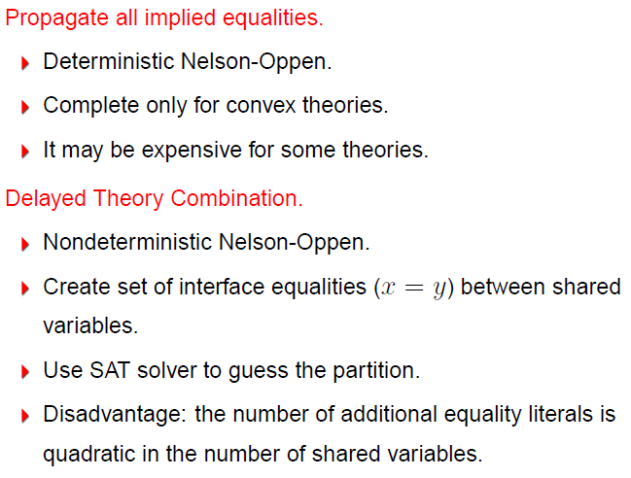
Combining Procedures in Practice

Slide 212
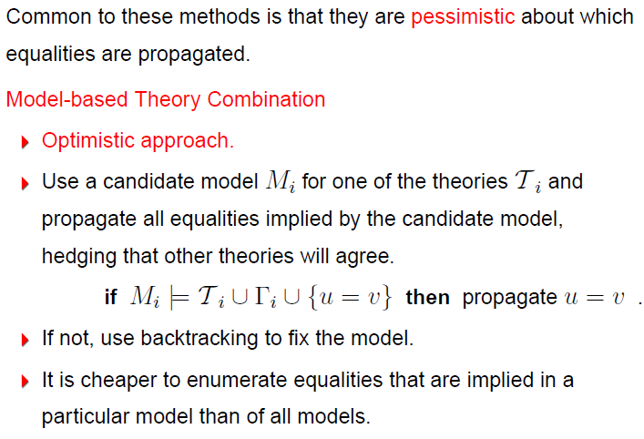
Combining Procedures in Practice

Slide 213
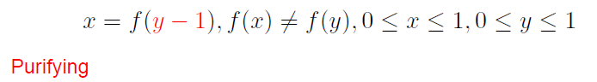
Example

Slide 214
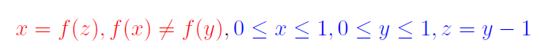
Example

Slide 215
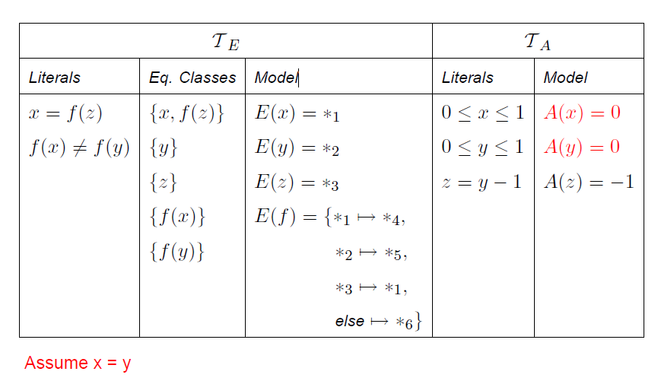
Example

Slide 216
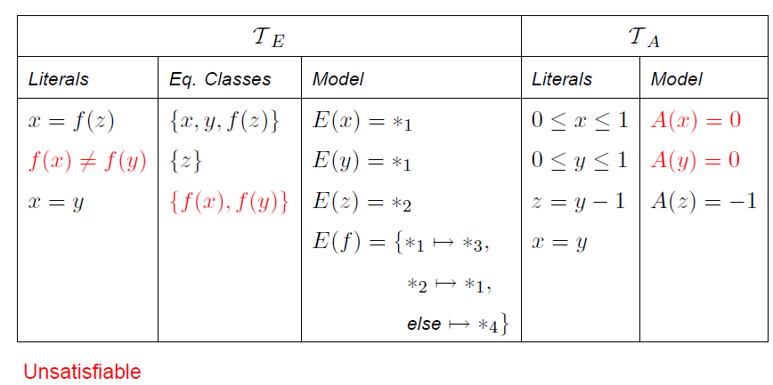
Example

Slide 217
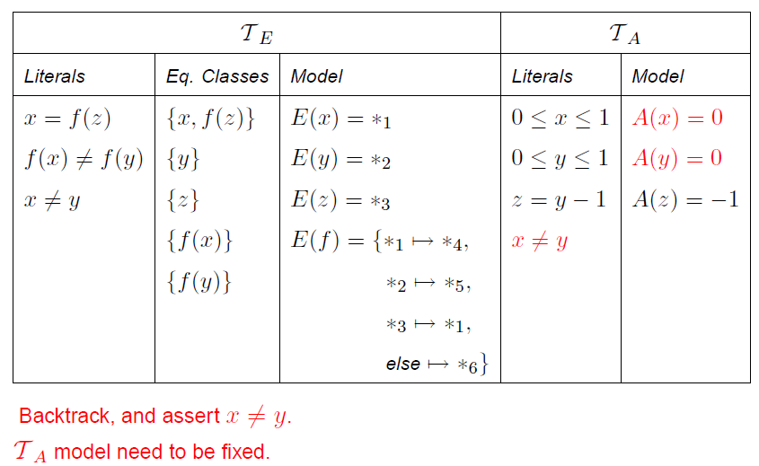
Example

Slide 218
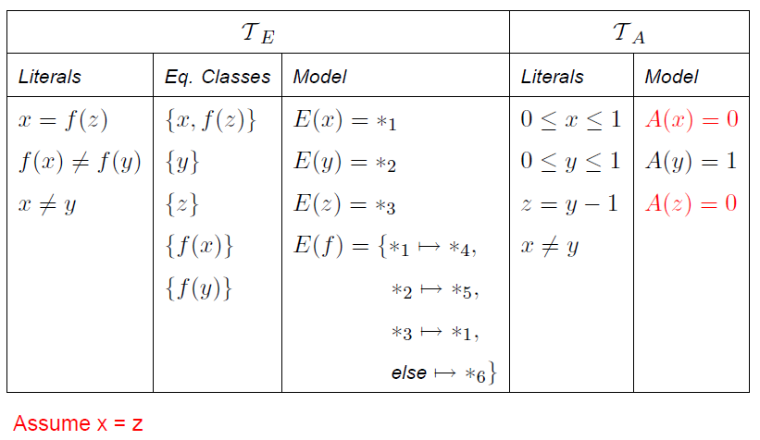
Example

Slide 219
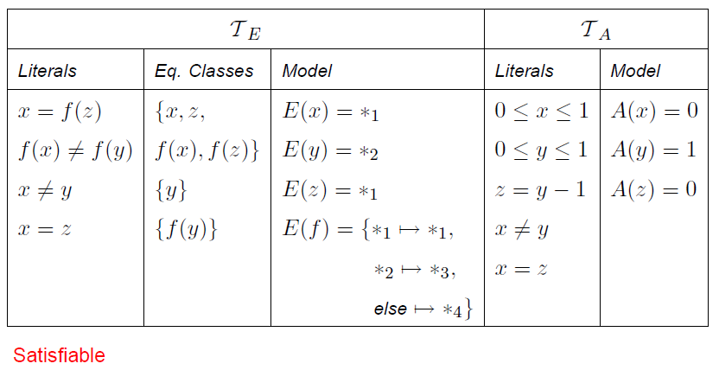
Example

Slide 220
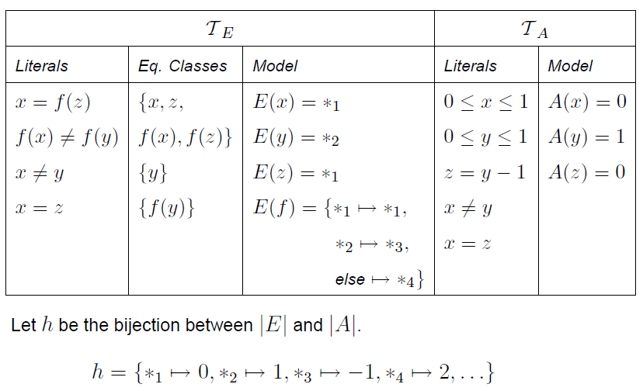
Example

Slide 221
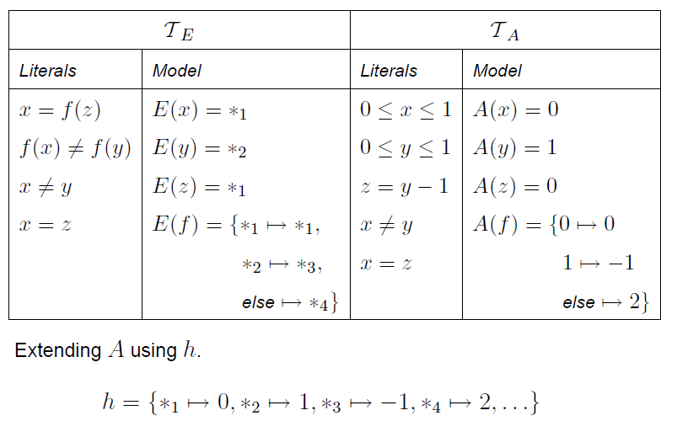
Example

Slide 222
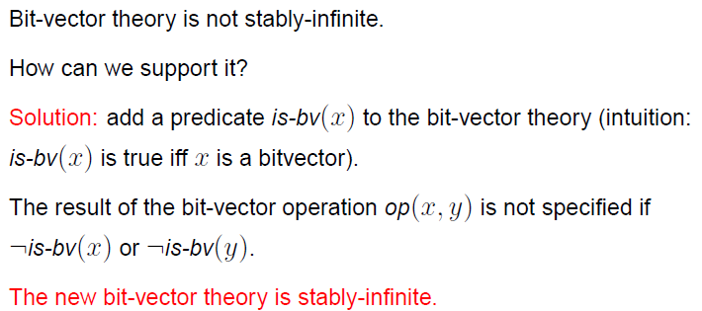
Non-stably infinite theories in practice

